Slide 1
Express Services, Inc. 2018
Notes:
Job Genius – brought to you by Express Employment Professionals

Slide 2
What’s the right education path for the job you want?
Notes:
What is Job Genius? It is an educational video series to help you choose the right education path and provide guidance on entering the workforce.

Slide 3
Insight and education for people entering the workforce
Career Options and Education
Workforce Entry and Job Search
Career Development
Notes:
Why are we bringing this to you?
Insight and education for people entering the workforce
Inform viewers about what jobs are trending and what type of education you need to get them
Help prepare you to search for a job.
Frequently, Express works with schools and associations such as, the national Association of Career and Technical Educators, and groups such as FFA, to provide insight on what jobs are trending and how to get hired. Express wants to help all job seekers, even if we can’t find them a job right now.
The Job Genius program does two things:
It allows Express to speak to schools and community groups and advise the future workforce on what to consider when pursuing a career path and how to get hired
It gives real advice to job seekers in a quick format to help them succeed in their job search. The videos are short enough to watch, around 15 minutes or less per video but long enough to provide specific advice and detail.

Slide 4
Career Options and Education
Job Market Trends
Jobs available with:
Workforce Entry and Job Search
Finding Job Openings
Résumé Tips
Career Development
Post Interview Steps
Creating a Career Path
High School Diploma
Bachelor’s Degree
Associates Degree
Interview Advice
Workplace Communication
Money Management
Notes:
The Job Genius series includes 11 core videos, along with introductory and conclusion videos. The videos can be grouped into three areas, Career Options and Education that informs you about what jobs are available, how to select a career, and how to plan for the cost and education of the your selected career. Next we equip you with everything you need for the job search, from looking for job opening to resume writing and formatting, and then interview best practices. The series closes with career development, covering critical steps for after the interview and your first day on the job, how to build a career path, advice on soft skills, what may be commonly known as workplace communication and relationships, and even how your financial management impacts your career.

Slide 5
Help as many people as possible find good jobs by helping as many clients as possible find good people.
Notes:
What is Express Employment Professionals? Express has been helping people find jobs for more than 35 years. We’re a network of more than 800 locally-owned offices that help as many people as possible find good jobs by helping as many clients as possible find good people. Currently, Express employs more than 540,000 people each year and is on a mission to put a million people to work annually.
If you haven’t worked with a staffing company before; in short, our client companies pay us to find talented workers to meet their production demands. Job seekers never pay a fee at Express for us finding them a job. Job assignments can be everything from contract positions to direct placements in full-time roles with our client companies.

Slide 6
90% of high school students are directed to go to college
Half of all STEM jobs require less than a bachelor’s degree
A postsecondary education is planned by 88% of career technology education students
Notes:
There is a disconnect between how high school students prepare for the work place and the skills that are in demand. A third of jobs require an associates degree or certification, but 90% of people are being directed toward a traditional 4-year degree.
30 percent of jobs created from now to 2020 will require some college or a two-year associate degree. (Carnevale et al., Recovery: Job Growth and
Education Requirements Through 2020, Georgetown University Center on Education and the Workforce, 2013)
Craig Brandon, author of “The Five Year Party,” said “High school guidance counselors recommend college for 90% of their graduates because it makes parents happy, and it is parents who need to wake up to the new economic reality of higher education.” (Craig Brandon, author of “The Five Year Party: How Colleges Have Given Up on Educating Your Child and What You Can Do About It”)
Half of all STEM jobs require less than a bachelor’s degree (Rothwell, The Hidden STEM economy, Brookings Institution, 2013)
Postsecondary education is planned for 88% of Career Technology Education students. (My College Options®/ACTE research study (2016). National sample includes 40,192 high school CTE students.)

Slide 7
Free program
Worksheets for each video
Guides for facilitators and parents
ExpressPros.com/JobGenius
Notes:
This educational program is available at ExpressPros.com/JobGenius.
We are collecting some information about who is using the program, so there is a short form you’ll be asked to complete. Then bookmark the next page so you don’t have to complete the form again.
The Job Genius series is a completely free resource. It’s one more way we can invest in the future workforce and equip individuals for success.
Along with the video educational series, you can download worksheets to follow along with each video and guides for presenting the information.

Slide 8
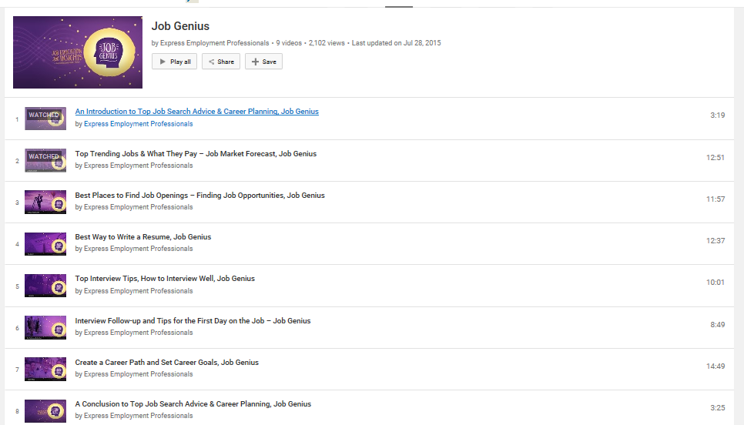
Free program
Worksheets for each video
Guides for facilitators and parents
YouTube.com/ExpressEP
Notes:
You can also find all the videos on our Express YouTube channel. Job Genius has its own playlist, which you can share directly on social media or use as a way to access the video content yourself.
If you can’t remember how to access our channel, just go to ExpressPros.com and click on the YouTube link in the bottom left corner of the home page.

Slide 9
Career Options and Education
Videos Include:
Job Market Forecast
Hot Jobs with High School Diplomas and Apprenticeships
Trending Career Tracks for Associate Degrees
Jobs with Bright Futures for Bachelor’s Degrees

Slide 10
JOB GENIUS INTRODUCTION
Link to Video
Notes:
Intro Video Slide (3 minutes)

Slide 11
QUESTIONS?
?
?
?
?
?
?
?
?
?
Notes:
Discussion: What questions do you have about finding a job and entering the workforce?

Slide 12
Job Market Forecast
Job Market
Education Options
Opportunities & Salaries
Notes:
Job Market Forecast: In the next 10 years, 20 million jobs will be created in the U.S. and 6 million in Canada.
The Job Market Forecast video will cover, industries that are growing, education options, how to research job opportunities, and salary expectations.

Slide 13
JOB MARKET FORECAST
Link to Video
Notes:
Job Market Forecast Video (13 minutes)

Slide 14
DISCUSSION:
What changes in our environment and economy influence the job market?
Have you considered the financial and time investment in education vs. the job opportunities available?
Notes:
Discussion: What changes in our environment and economy influence the job market? Have you considered the financial and time investment in education versus the job opportunities available?

Slide 15
Hot Jobs with High School Diplomas and Apprenticeships
Link to Video
Notes:
Hot Jobs with High School Diplomas and Apprenticeships Video (18 minutes)

Slide 16
DISCUSSION:
What is surprising about the jobs featured in this video?
Why would you consider not continuing your education after high school?
Notes:
Discussion: What is surprising about the jobs featured in this video? Why would you consider not continuing your education after high school?

Slide 17
Trending Career Tracks for Associate Degrees
Link to Video
Notes:
Trending Career Tracks for Associate Degrees Video (17 minutes)

Slide 18
DISCUSSION:
How important is the typical schedule for the job that interests you?
Do you want a career that helps others?
Notes:
Discussion: How important is the typical schedule for the job that interests you? For example, do you want the flexibility to have days off during the week or work rotating shifts? Do you want a career that helps others?

Slide 19
Jobs with Bright Futures for Bachelor’s Degrees
Link to Video
Notes:
Jobs with Bright Futures for Bachelor’s Degrees Forecast Video (15 minutes)

Slide 20
DISCUSSION:
How much debt are you comfortable acquiring for college?
Do you plan to work while attending college?
Have you evaluated hiring activity for the job you are interested in?
Notes:
Discussion: If you need student loans to attend college, how much are you comfortable with? Will you work while you are in college? (This is an opportunity to mention temporary and flexible work through Express.) Have you determined the level of hiring activity in the field/degree you are pursing?

Slide 21
Workforce Entry and Job Search
Videos Include:
Finding Job Opportunities
Your Résumé
The Interview

Slide 22
Job Opportunities
Job Postings
Networking
Job Fairs
Job Descriptions
Notes:
Finding Job Opportunities: Did you know 75% of hiring managers are using social networks to find candidates for jobs? In this video you’ll learn: Where to look for job openings, networking advice, job fair tips, and a guide for job descriptions.

Slide 23
FINDING JOB OPPORTUNITIES
Link to Video
Notes:
Finding Job Opportunities Video (12 Minutes)

Slide 24
DISCUSSION:
What sources do you have for finding job openings?
How do you manage your social networks while job searching?
Notes:
Discussion: What sources do you have for finding job openings?
How do you manage your social media while job searching?

Slide 25
The Résumé
Skills & Accomplishments
Education
Experience & Work History
Notes:
There are three parts to a résumé: skills and accomplishments, education, and experience and work history. Now, let’s learn about the best ways to communicate and format this information.

Slide 26
THE RÉSUMÉ
Link to Video
Notes:
The Résumé video (12 minutes)

Slide 27
DISCUSSION:
What résumé format is best for you?
Who could you have review and proofread your résumé?
Notes:
Discussion: What résumé format best demonstrated your abilities and experience? Who could you have review and proofread your résumé? Proofreading means having it reviewed for grammatical errors, typos, formatting and structural formatting.

Slide 28
The Interview
Preparation
Research
Notes:
The Interview: A successful interview takes preparation and research.
This video will cover: How to research the job and company, questions to be prepared to answer, questions to ask, what to bring with you, interview etiquette, and how to uncover key details you’ll need to successfully followup after the interview.

Slide 29
THE INTERVIEW
Link to Video
Notes:
The Interview video (10 Minutes)

Slide 30
DISCUSSION:
Why is it important to review the job description prior to the interview?
What attire is appropriate for an interview?
Notes:
Discussion: Why is it important to review the job description prior to the interview? What attire is appropriate for an interview?

Slide 31
Career Development
Videos Include:
After the Interview
Career Pathing
Soft Skills for Career Success
Tips for Money Management

Slide 32
After the Interview
Follow Up
Understanding Compensation
How to Prepare for Your First Day on the Job
Documents You’ll Need
Notes:
After the Interview, what are your next steps?
A thank you note is still an important way to demonstrate your interest in the job and showcase a specific soft skill – communication!
In this video you’ll learn: How to follow up after an interview, review and understand compensation details – like hourly versus salary and gross versus net pay, how to prepare for your first day on the job and what documents you’ll need to bring.

Slide 33
AFTER THE INTERVIEW
Link to Video
Notes:
After The Interview video (10 Minutes)

Slide 34
DISCUSSION:
What are the essential details for a follow-up thank you note?
What is the difference between hourly and salary pay?
Notes:
Discussion: What are the essential details for a follow-up thank you note? What is the difference between hourly and salary pay?

Slide 35
Career Pathing
Hard & Soft Skills
Setting Career Goals

Slide 36
CAREER PATHING
Link to Video
Notes:
Career Pathing video (15 minutes)

Slide 37
DISCUSSION:
How are your soft skills demonstrated to a potential employer throughout the job application process?
Who can help review your career path action plan?
Notes:
Discussion: How are your soft skills demonstrated to a potential employer throughout the job application process?
Who can help review your career path plan?

Slide 38
Soft Skills for Career Success
Link to Video
Notes:
Soft Skills for Career Success video (13 minutes)

Slide 39
DISCUSSION:
How important is your ability to communicate with others in the workplace?
What role does flexibility play in the workplace?
Notes:
Discussion: How important is your ability to communicate with others in the workplace? What role does flexibility play in the workplace?

Slide 40
Tips for Money Management
Link to Video
Notes:
Tips for Money Management video (15 minutes)

Slide 41
DISCUSSION:
Do you have a living expenses budget?
How does financial planning impact your career?
Notes:
Discussion: Do you have a living expenses budget? How does financial planning impact your career?

Slide 42
Job Trends
Education Options
Finding Job Openings
Résumés
Interviews
Career Planning
Notes:
Conclusion: Throughout this series we’ve covered everything you need to do to succeed in a getting a job, including determining jobs that are trending, education options, finding job openings, résumés, interviewing, and how to plan your career path.

Slide 43
JOB GENIUS SUMMARY
Link to Video
Notes:
Conclusion video (3 minutes)

Slide 44
DISCUSSION:
Which part of the job search and hiring process is easiest for you to influence?
Notes:
Discussion: Which part of the job search and hiring process is easiest for you to influence?

Slide 45
Parent Guide
Tips for parents or guardians and the purpose of each video
Discussion questions for each video
Download via ExpressPros.com/JobGenius
Notes:
To help parents or guardians discuss Job Genius with young adults, Express has provided a free parent guide available for download at ExpressPros.com/JobGenius.
The guide features descriptions of each video, relevant tips on the video topic, and questions or activities related to each video to help engage in a conversation about the video topic.
For schools and associations consider sharing the parent guide via your school website or parent communication avenues.

Slide 46
Notes:
Evaluation (complete the survey provided by Express Employment Professionals)

Slide 47
ExpressPros.com
Notes:
Express logo with “Find a location near you at ExpressPros.com”

